Slide 1





ORPHANAGE LIFE FOUNDATION
- A Path To HOPE
Team Members:
Guide:
Govindaswamy Varshitha
Armugam Rohith Sai Reddy
Depuru Sai Sowmya
Umamaheswari R

Slide 2
ORPHANAGE LIFE FOUNDATION
OUTLINE
Abstract
Problem Statement
Aims, Objective & Proposed System/Solution
System Design/Architecture
System Development Approach (Technology Used)
Algorithm & Deployment
Conclusion
Future Scope
References
Video of the Project
Notes:
These are the list of chapters that we are going to cover in these foundation codes. Those are chapter one what are AI and ML? chapter 2 applied Python programming in AI, and chapter 3 is exploratory data analysis for ML.

Slide 3
Abstract
ORPHANAGE LIFE FOUNDATION
The "Orphanage Life Foundation" is a compassionate initiative utilizing technology to connect individuals with the noble cause of supporting orphanages. This user-friendly website empowers users to contribute to underprivileged children's welfare through donations of food, clothes, and monetary funds. The platform enhances personalization by allowing users to specify quantities and choose preferred orphanages, creating a direct link between donors and beneficiaries with the aid of third-party collaborations. Community engagement is fostered through a feedback mechanism, enabling donors to share experiences and contact the foundation, promoting transparency. User registration ensures a secure and trustworthy platform, aiming to build a bridge of compassion, connecting those eager to make a positive impact with orphanages in need, fostering a sense of community and shared responsibility.

Slide 4
Problem Statement
ORPHANAGE LIFE FOUNDATION
In contemporary society, orphanages often struggle to meet the diverse and critical needs of underprivileged children due to resource constraints. There are many orphans increasing day by day according to the statistical analysis. So as a part of this the orphanages could not be able to provide proper accommodation for the orphans. In turn here we are here to develop a website improving the helping hands to others. The 'Orphanage Life Foundation' project seeks to address challenges within the orphanage system by implementing innovative solutions to enhance the overall well-being and future prospects of orphaned and vulnerable children.

Slide 5
Aim and Objective
ORPHANAGE LIFE FOUNDATION
Aim: The primary aim of the “Orphanage Life Foundation” is to create a user-friendly online platform that encourages and facilitates charitable contributions for orphanages, focusing on essential items such as food and clothes. Establishes a seamless connection between donors and nearby orphanages to meet an orphan basic requirements.
Objective:
Develop an intuitive website enabling users to effortlessly register, log in, and navigate through the donation process seamlessly.
Implement a straightforward system for categorizing donations into food, clothes, and monetary contributions. Allow users to specify quantities and choose their preferred orphanage.
Integrate a feedback mechanism for users to share experiences, fostering transparency. Implement a communication portal on the website, facilitating easy contact with the foundation for inquiries, feedback, and additional information.

Slide 6
Proposed System/Solution
ORPHANAGE LIFE FOUNDATION
The proposed solution for the Orphanage Life Foundation project is a comprehensive online platform designed to facilitate and streamline charitable contributions for orphanages. Leveraging HTML, CSS, JavaScript, and PHP, the user-friendly website enables individuals to make donations of food, clothes, and monetary funds. Through a secure registration and login system, users can choose their preferred orphanage and contribute based on specific needs. The platform incorporates a feedback mechanism to enhance transparency and user engagement, allowing donors to share their experiences. Additionally, a communication portal facilitates easy contact with the foundation. The use of the XAMPP server with phpMyAdmin ensures robust data management. This solution not only connects donors directly with nearby orphanages but also promotes a sense of community engagement, fostering compassion and support for the well-being of orphans.

Slide 7
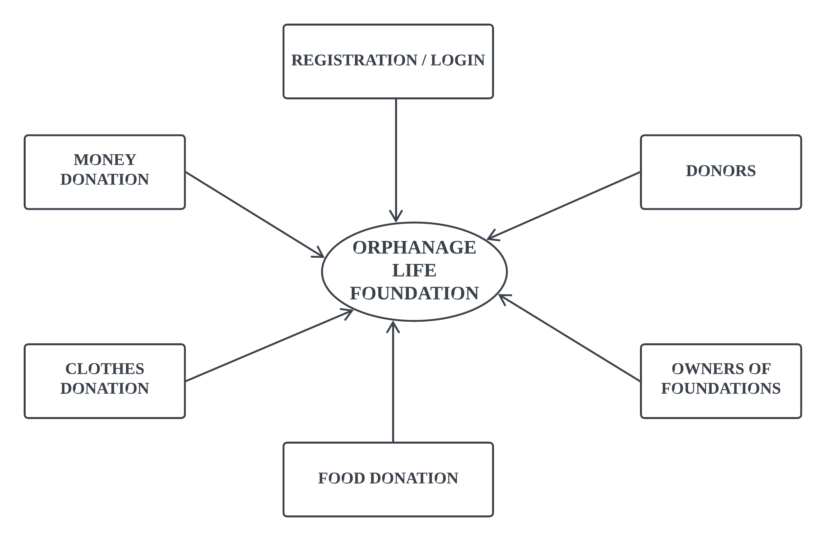
System Architecture
ORPHANAGE LIFE FOUNDATION

Slide 8
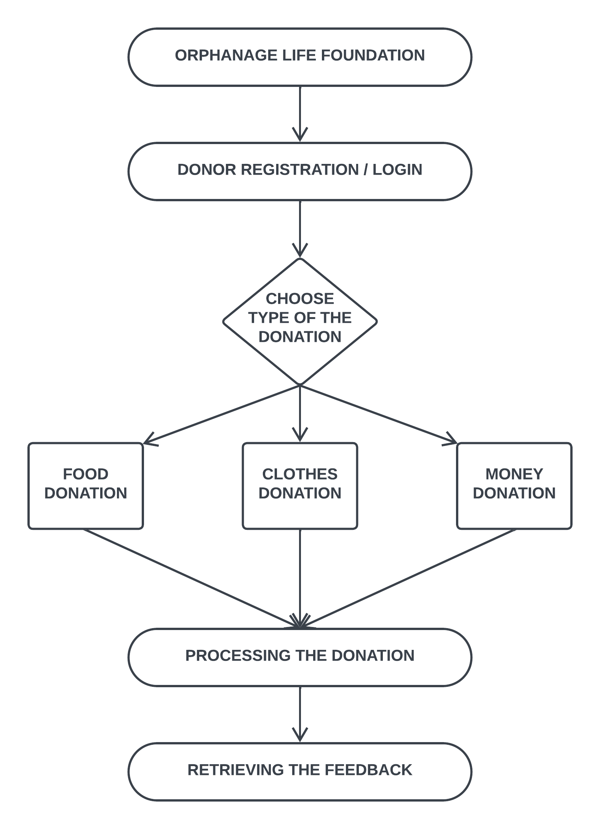
System Design
ORPHANAGE LIFE FOUNDATION

Slide 9
System Development Approach
ORPHANAGE LIFE FOUNDATION
Frontend Technologies:
HTML (Hyper Text Markup Language):
Utilized for structuring the website and creating the basic layout.
Responsible for defining the elements and content of web pages.
CSS (Cascading Style Sheets):
Employed for styling and formatting the HTML elements.
Ensures a visually appealing and consistent design across the website.
JavaScript:
Implemented for dynamic and interactive features on the client side.
Enhances user experience through functionalities such as form validation and asynchronous communication with the server.

Slide 10
System Development Approach
ORPHANAGE LIFE FOUNDATION
Backend Technologies:
PHP (Hypertext Preprocessor):
Used as the server-side scripting language to handle dynamic content.
Responsible for processing user input, managing database interactions, and executing server-side logic.
XAMPP Server:
XAMPP is a cross-platform web server solution that includes Apache, MySQL, PHP, and Perl.
Apache is the web server responsible for serving web pages.
MySQL is the relational database management system (RDBMS) used for storing and retrieving data.
PHP interacts with the Apache server to dynamically generate content and communicate with the MySQL database.
phpMyAdmin:
A web-based tool for managing MySQL databases.
Used for database administration, including creating, modifying, and querying the database.

Slide 11
Algorithm & Deployment
ORPHANAGE LIFE FOUNDATION
Donation Processing Algorithm: The donation processing involves algorithms to handle user input validation, database interaction for storing donation details, and communication with third-party logistics if applicable. This algorithm ensures that the donated items are appropriately recorded, categorized, and directed to the chosen orphanage.
User Authentication Algorithm: Algorithms for user registration, login, and authentication involve secure practices such as hashing passwords before storage. These algorithms ensure the security and integrity of user accounts.
Orphanage Selection Algorithm: The algorithm here involves retrieving and displaying a list of nearby orphanages based on user preferences. It may incorporate distance calculation and sorting to provide users with a convenient selection process.
Feedback Processing Algorithm: The algorithm for handling user feedback includes capturing input through forms, validating the data, and storing it in the database. It may also involve notifying administrators or relevant parties about new feedback.

Slide 12
Deployment
ORPHANAGE LIFE FOUNDATION
Deployment in the context of software development refers to the process of making a developed application or system available and accessible for use. It involves the transition from a development environment to a production environment, where the software can be utilized by end-users. It involves the following :
Database Setup
Server Configuration
Security Measures
Maintenance
User Access

Slide 13
Conclusion
ORPHANAGE LIFE FOUNDATION
The Orphanage Life Foundation project represents a significant step towards leveraging technology for social good. By developing a user-friendly website, we have created a platform that connects compassionate individuals with orphanages in need. The incorporation of HTML, CSS, JavaScript, and PHP, along with the use of the XAMPP server and phpMyAdmin, provides a robust technological foundation. The system facilitates seamless charitable contributions, allowing users to donate food, clothes, and money to their chosen orphanages. The project promotes transparency through a feedback mechanism, enhancing accountability and trust. Through careful consideration of user experience and security measures, the deployed system aims to provide a secure, scalable, and efficient platform. As we deploy the project, continuous monitoring, maintenance, and potential scaling will be essential to ensure its ongoing success. The Orphanage Life Foundation stands as a testament to the potential of technology to make a positive impact on the lives of those in need and to bring communities together in the spirit of compassion and generosity.

Slide 14
Future Scope
ORPHANAGE LIFE FOUNDATION
The future scope of the Orphanage Life Foundation project holds significant potential for expansion, enhancement, and increased impact. Here are some potential avenues for future development:
Geographic Expansion
Mobile Application Development
Integration with Social Media Platforms
Advanced Analytics and Reporting
Collaboration with cooperate partners
Educational Initiatives
The future scope of the Orphanage Life Foundation project is dynamic and can evolve in response to emerging technologies, societal needs, and collaboration opportunities. By staying adaptable and responsive to feedback, the project can continue to make a positive impact on the lives of orphaned children and the communities that support them.

Slide 15
ORPHANAGE LIFE FOUNDATION
References :
https://www.scribd.com/document/130499797/Synopsis-Final
https://www.ijraset.com/research-paper/web-application-for-medicine-food-books-and-cloth
https://www.operationhelpahero.org/
Video Link :
https://drive.google.com/file/d/1Unv6fGZPieV1s2dnTmF0BNQU8uhDYzMR/view?usp=drivesdk
GitHub Link :
https://github.com/Varshitha269/ORPHANAGE-LIFE-FOUNDATION
Notes:
Reference
These are the references for this session.
15

Slide 16
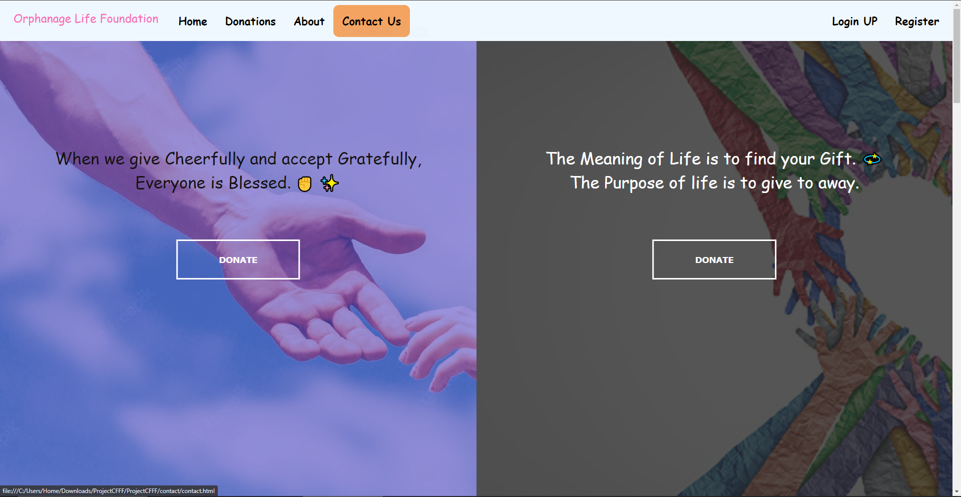
ORPHANAGE LIFE FOUNDATION
Screenshots:
Notes:
thank you very much for joining this PPT, keep learning.
16

Slide 17


ORPHANAGE LIFE FOUNDATION
Screenshots:
Notes:
thank you very much for joining this PPT, keep learning.
17

Slide 18
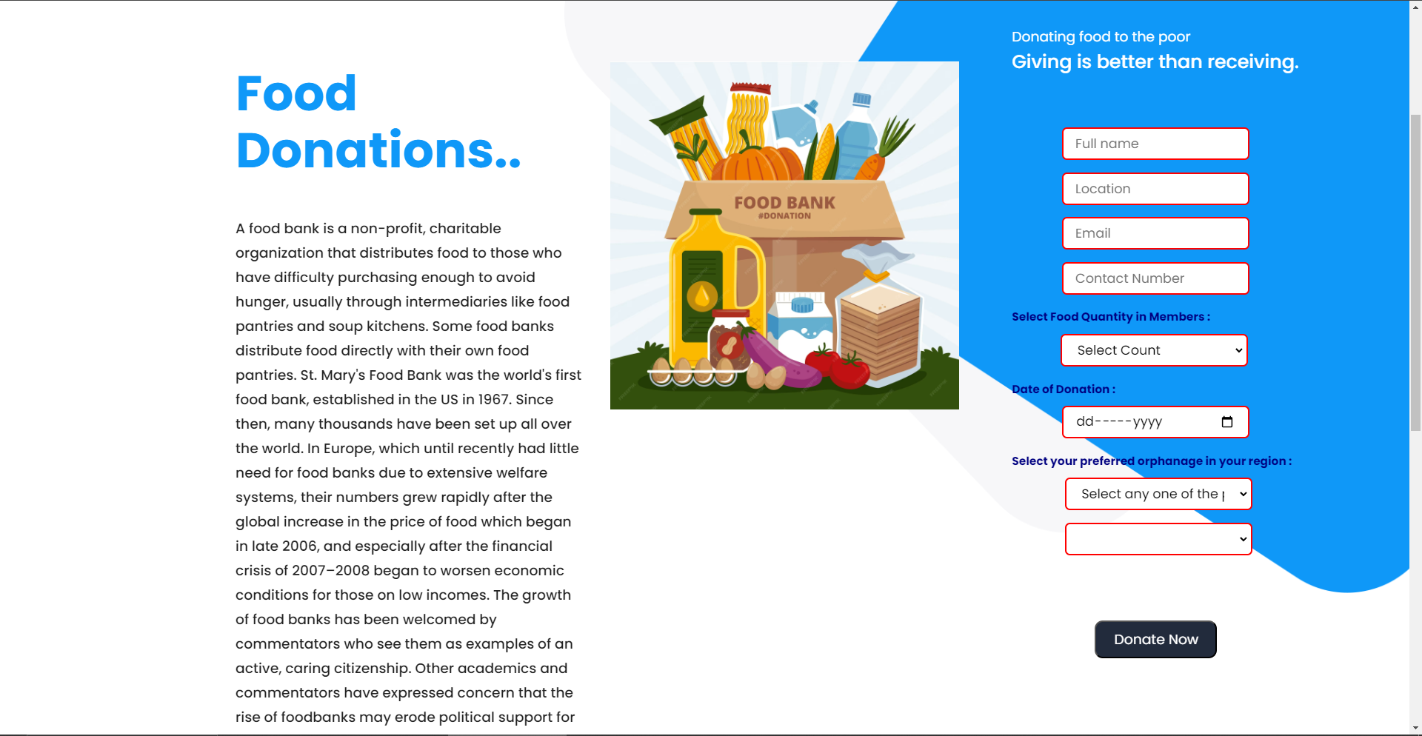
ORPHANAGE LIFE FOUNDATION
Screenshots:
Notes:
thank you very much for joining this PPT, keep learning.
18

Slide 19
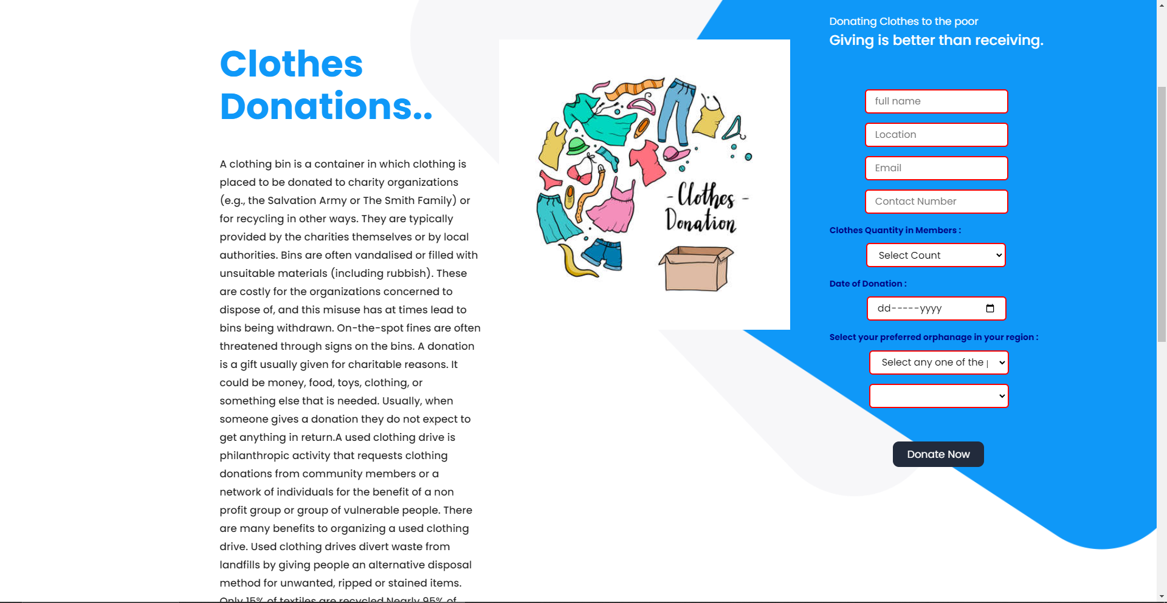
ORPHANAGE LIFE FOUNDATION
Screenshots:
Notes:
thank you very much for joining this PPT, keep learning.
19

Slide 20
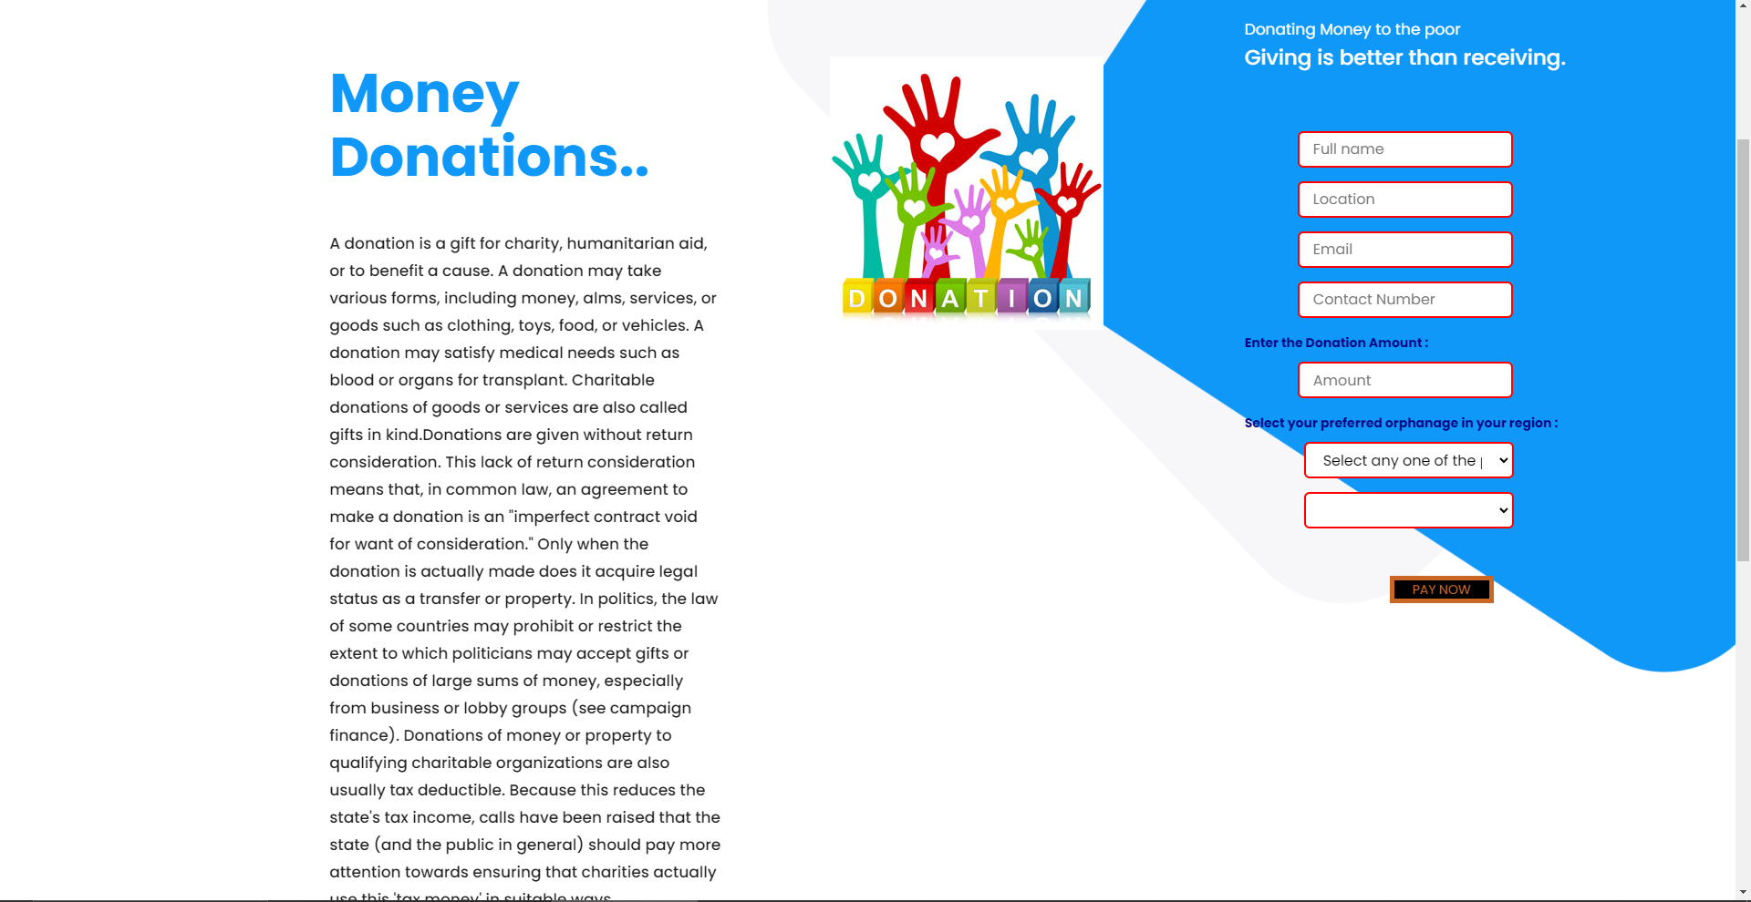
ORPHANAGE LIFE FOUNDATION
Screenshots:
Notes:
thank you very much for joining this PPT, keep learning.
20

Slide 21

ORPHANAGE LIFE FOUNDATION
Screenshots:
Notes:
thank you very much for joining this PPT, keep learning.
21

Slide 22
ORPHANAGE LIFE FOUNDATION
Thank you!
Notes:
thank you very much for joining this PPT, keep learning.
22

